Slide 1
Developing Applications with Go and NoSQL
Nic Raboy - @nraboy
Senior Developer Advocate at Couchbase

Slide 2
Creating a Web Application with Go

Slide 3
Go Multiplexers
Easier and more feature rich than the net/http package
Popular multiplexers
gorilla/mux
httprouter
bone

Slide 4
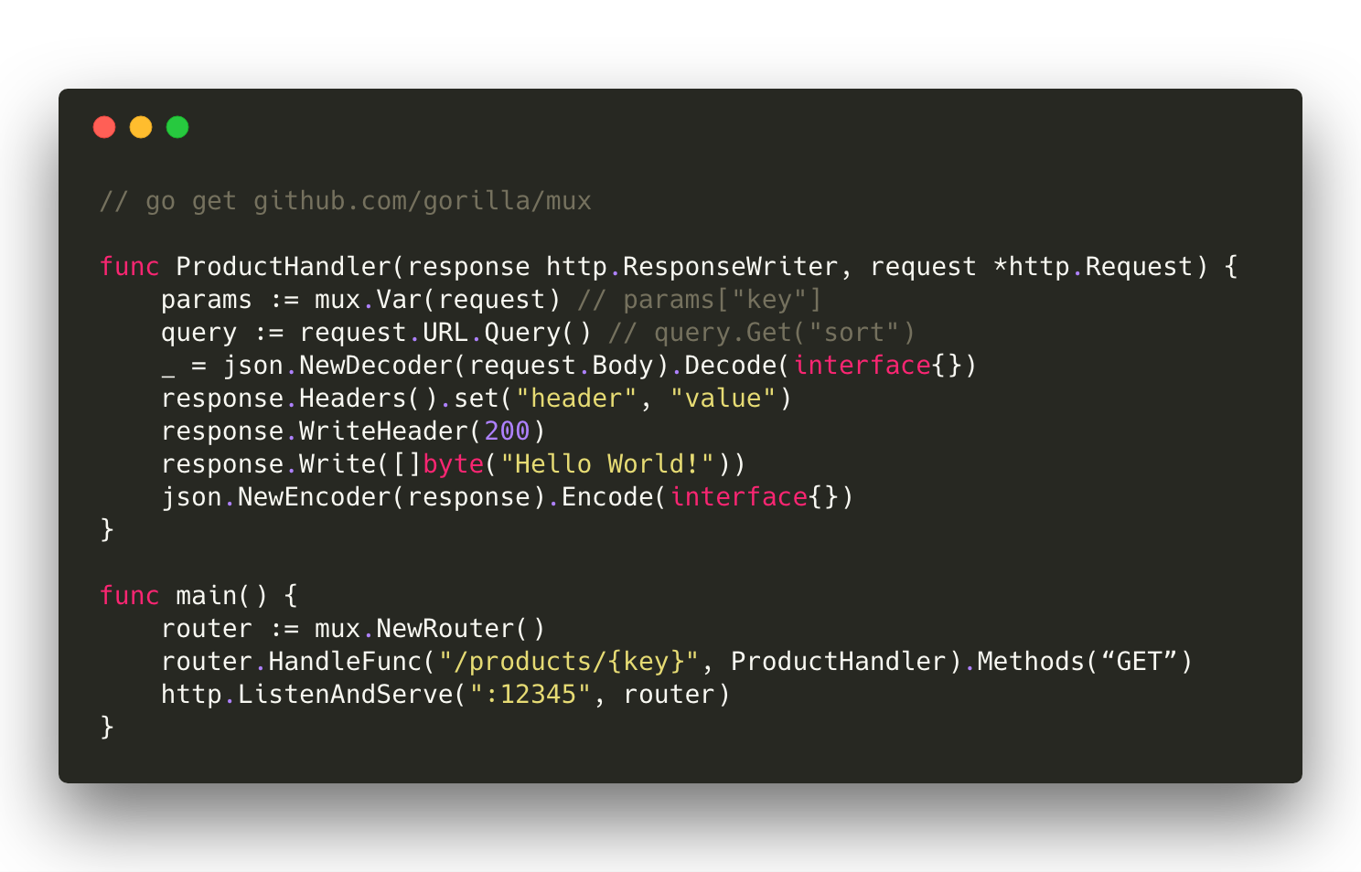

Slide 5
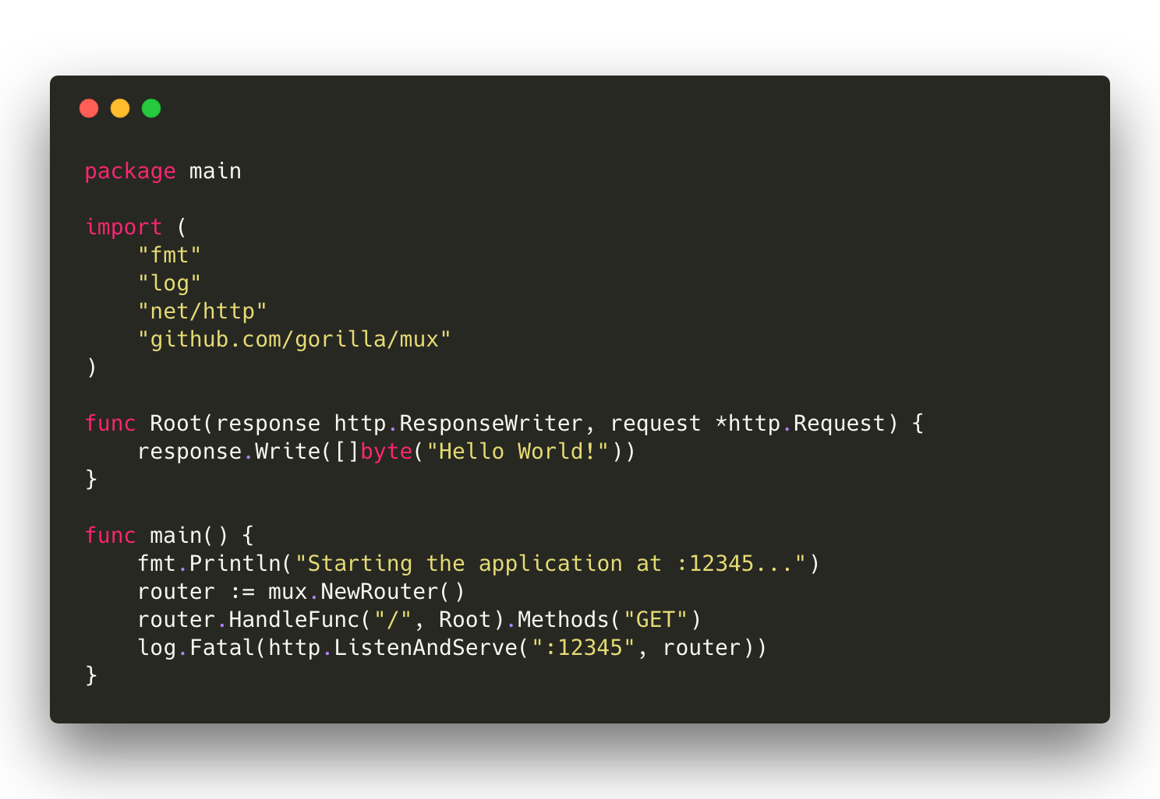

Slide 6
What is Couchbase?

Slide 7
Couchbase: The Complete Database Solution
Couchbase Lite
Sync Gateway
Couchbase Server
EMBEDDED DATABASE
SYNCHRONIZATION
DATABASE SERVER
Lightweight embedded NoSQL database with full CRUD and query functionality.
Secure web gateway with synchronization, REST, stream, batch and event APIs for accessing and synchronizing data over the web.
Highly scalable, highly available, high performance NoSQL database server.
SECURITY
Built-in enterprise level security throughout the entire stack includes user authentication, user and role based data access control (RBAC), secure transport (TLS), and 256-bit AES full database encryption.

Slide 8
Couchbase Lite Overview
Cross-platform support for all major operating systems and platforms
Built native from the ground up
500kb for most platforms
256-bit AES full database encryption
Couchbase Lite
Embedded Database

Slide 9
Couchbase Server Overview
Scale easily to thousands of nodes
Consistent high performance that supports millions of concurrent users
Flexible JSON data model
24x365 always-on availability
Couchbase Server
Database Server

Slide 10
Sync Gateway Overview
Synchronize data between Couchbase Lite and Couchbase Server
REST, Stream, Batch, and Event APIs
Pluggable authentication
Fine grained user and role based access control
Elastically scalable in real-time
Sync Gateway
Synchronization

Slide 11
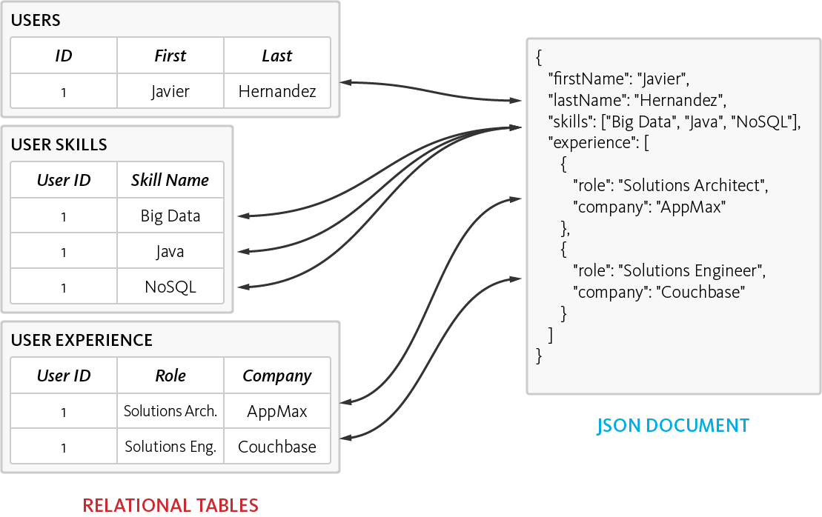
The Power of the Flexible JSON Schema
Ability to store data in multiple ways
De-normalized single document, as opposed to normalizing data across multiple table
Dynamic Schema to add new values when needed

Slide 12
Installing and Configuring Couchbase

Slide 13
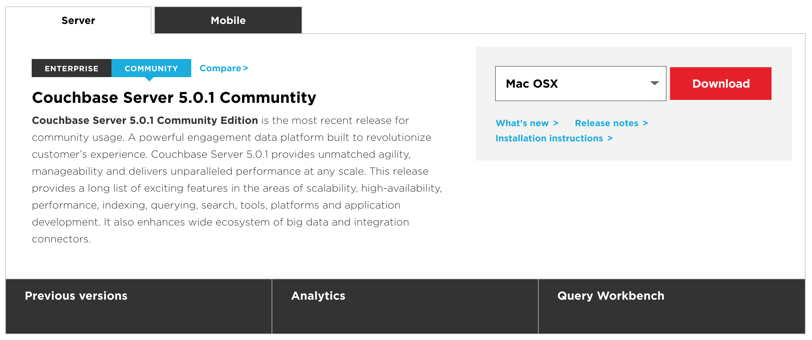
Downloading Couchbase Server
Download Couchbase Server Online
https://www.couchbase.com/downloads

Slide 14
Alternative Download Options
Docker
Amazon Web Services
Microsoft Azure

Slide 15
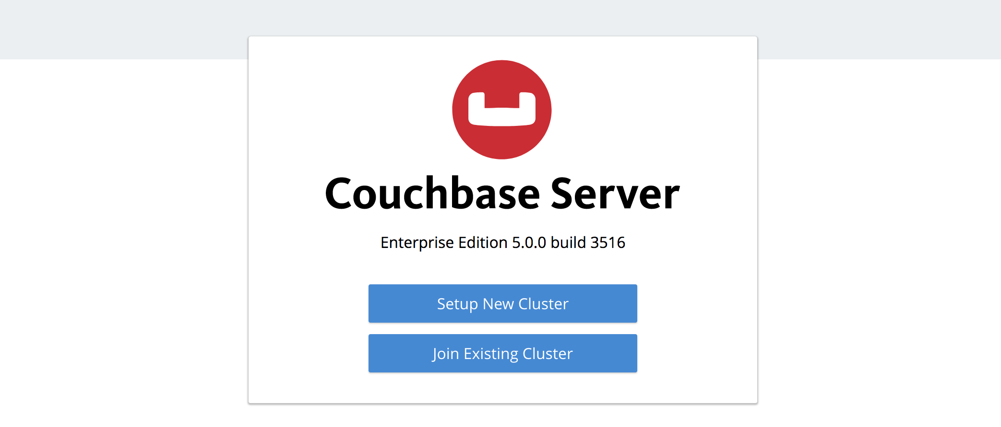
Installing Couchbase

Slide 16
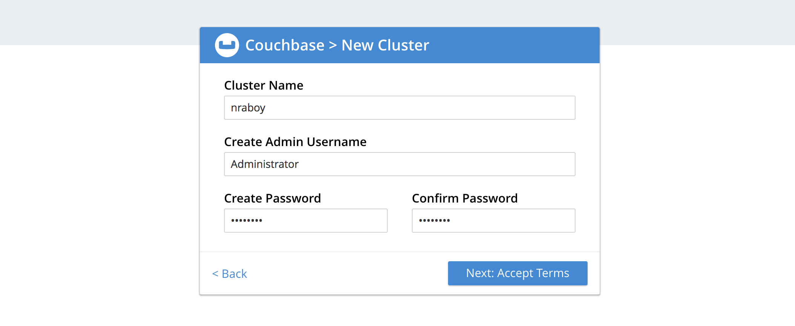
Installing Couchbase

Slide 17
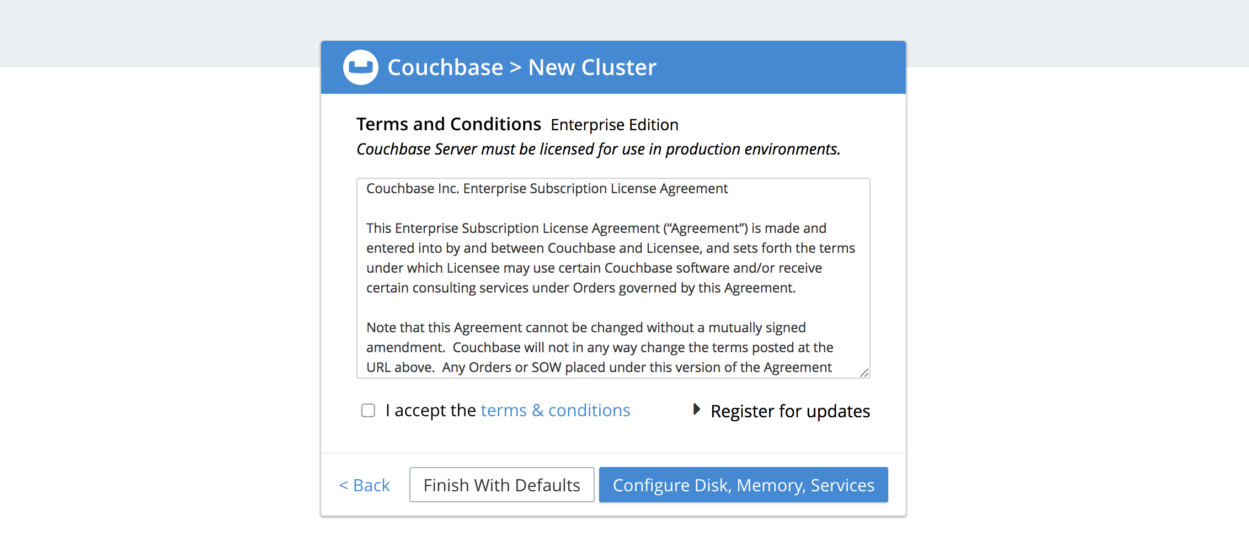
Installing Couchbase

Slide 18
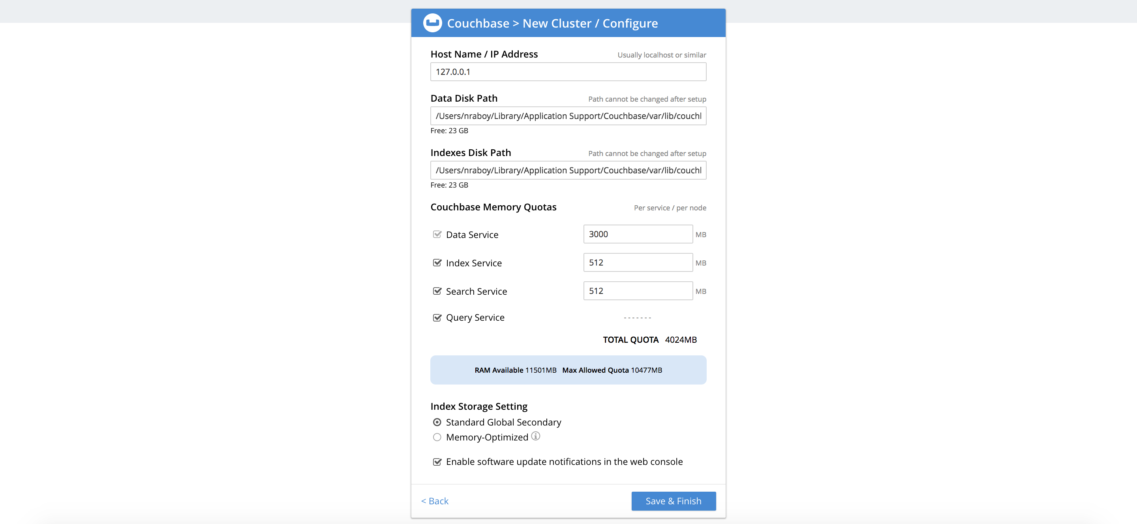
Installing Couchbase

Slide 19
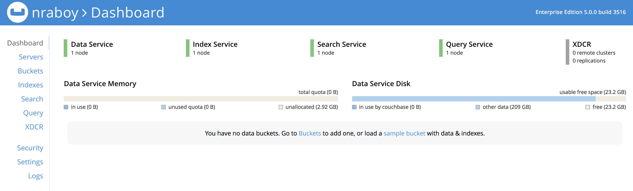
Installing Couchbase

Slide 20
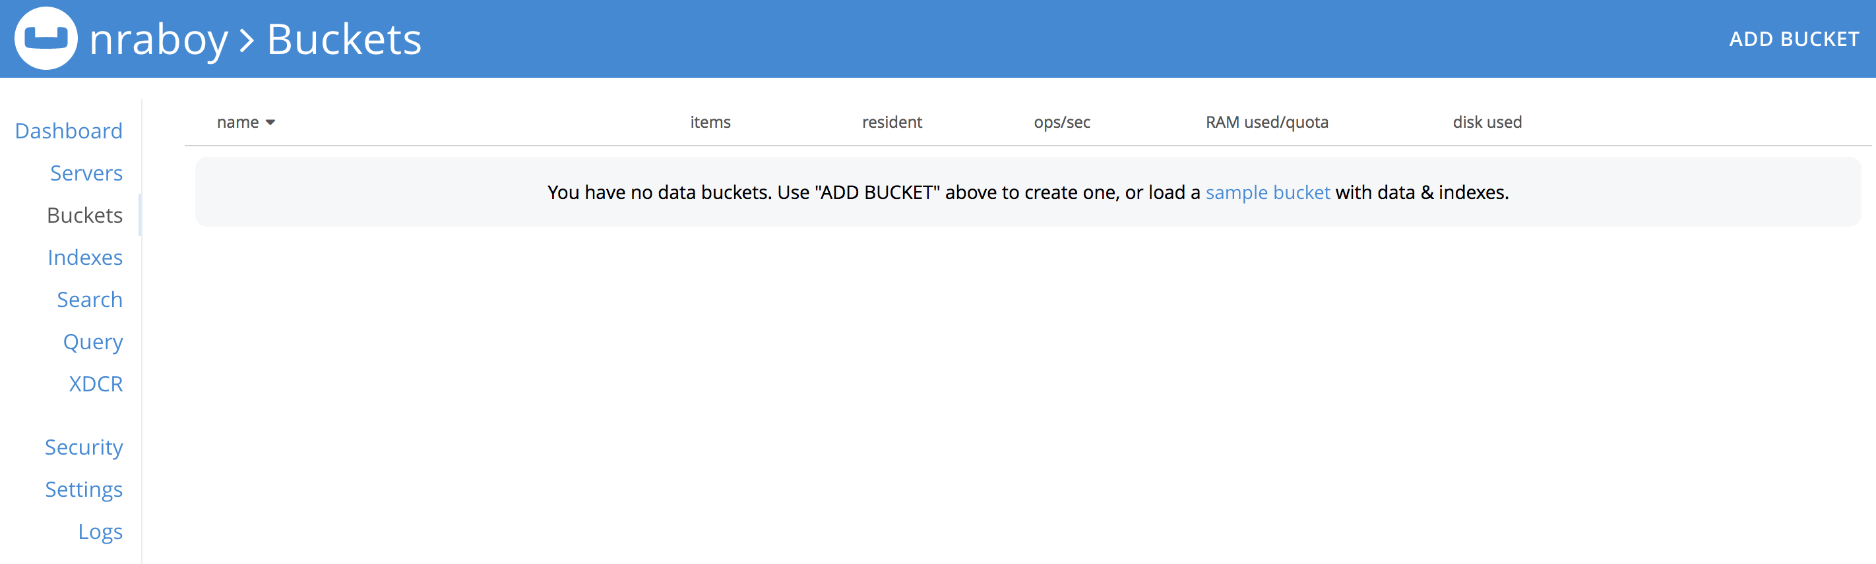
Working with Couchbase

Slide 21
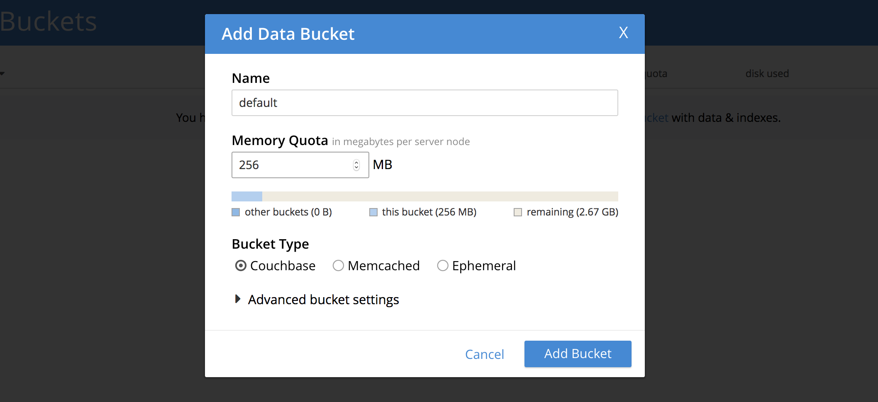
Working with Couchbase

Slide 22
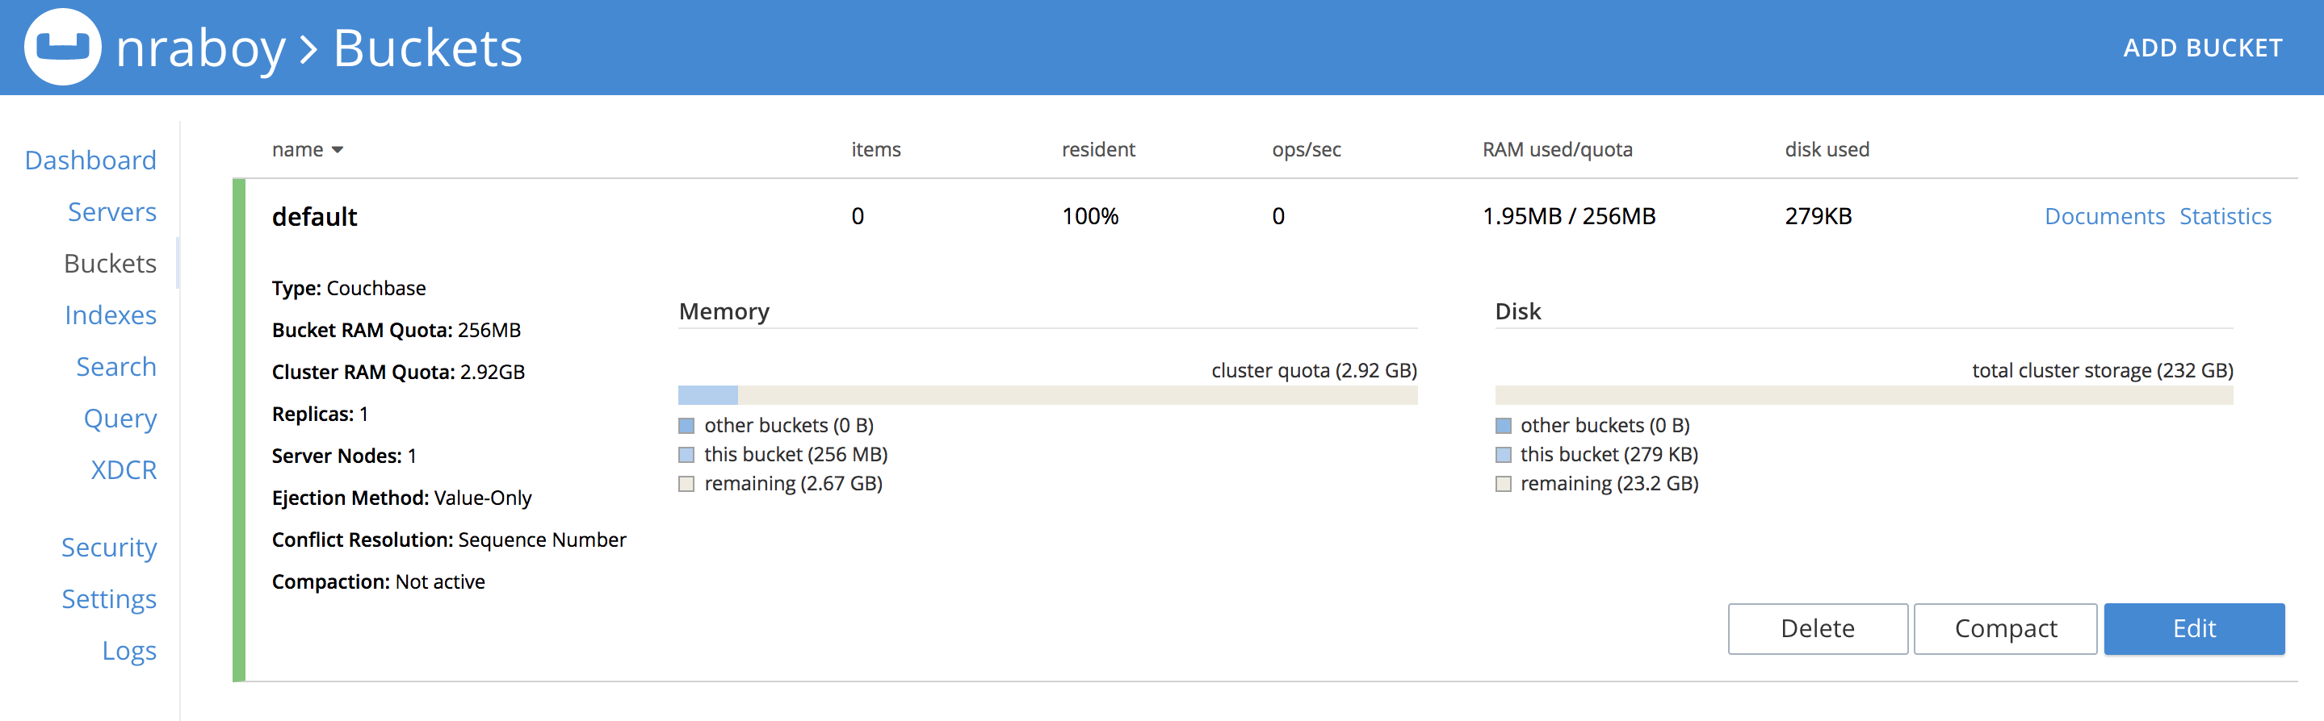
Working with Couchbase

Slide 23
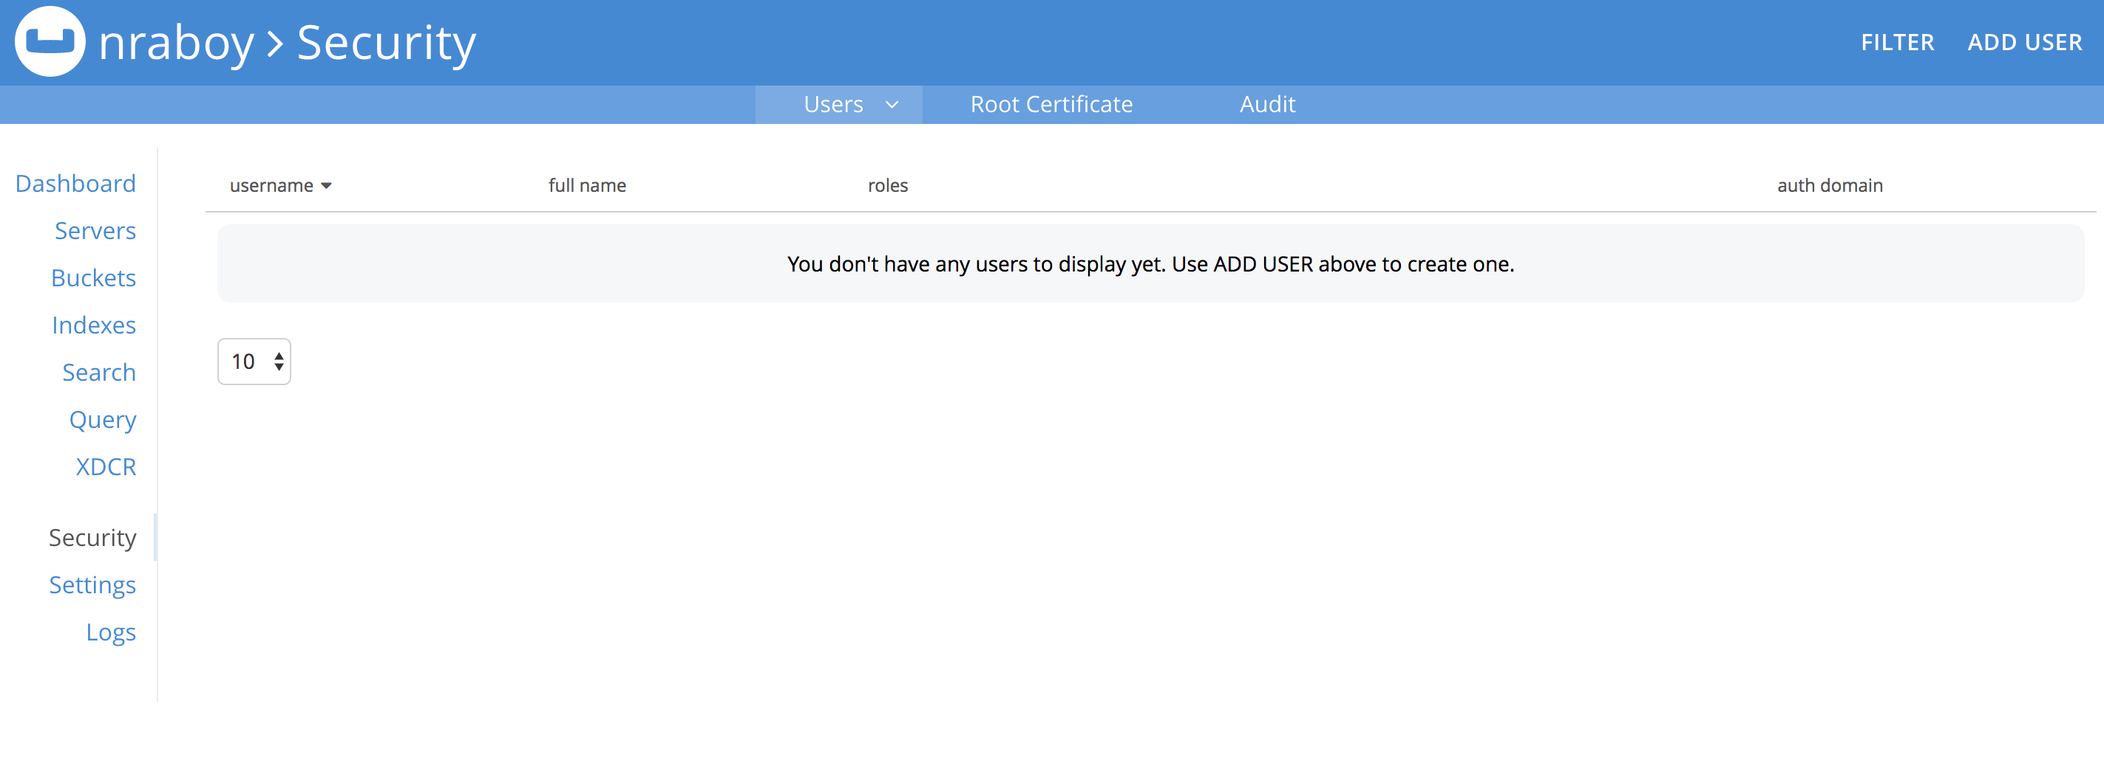
Role-Based Access Control (RBAC)

Slide 24
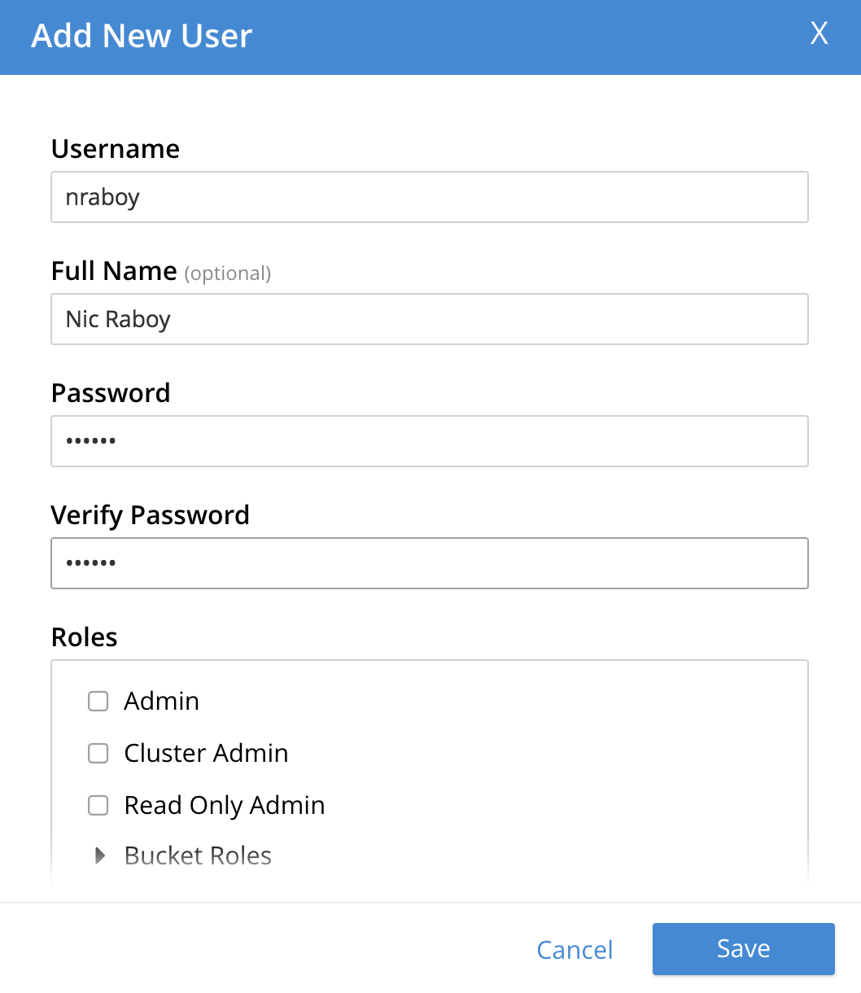
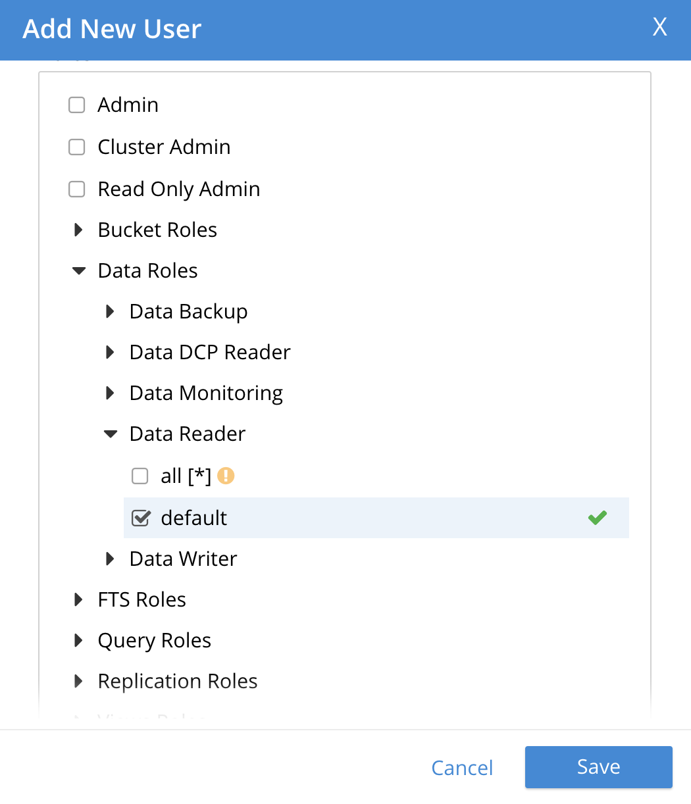
Role-Based Access Control (RBAC)
Cluster and Bucket Permissions
Data Reader / Writer for CRUD
Query for N1QL
FTS for Full Text Search

Slide 25
Using the Couchbase Go SDK

Slide 26
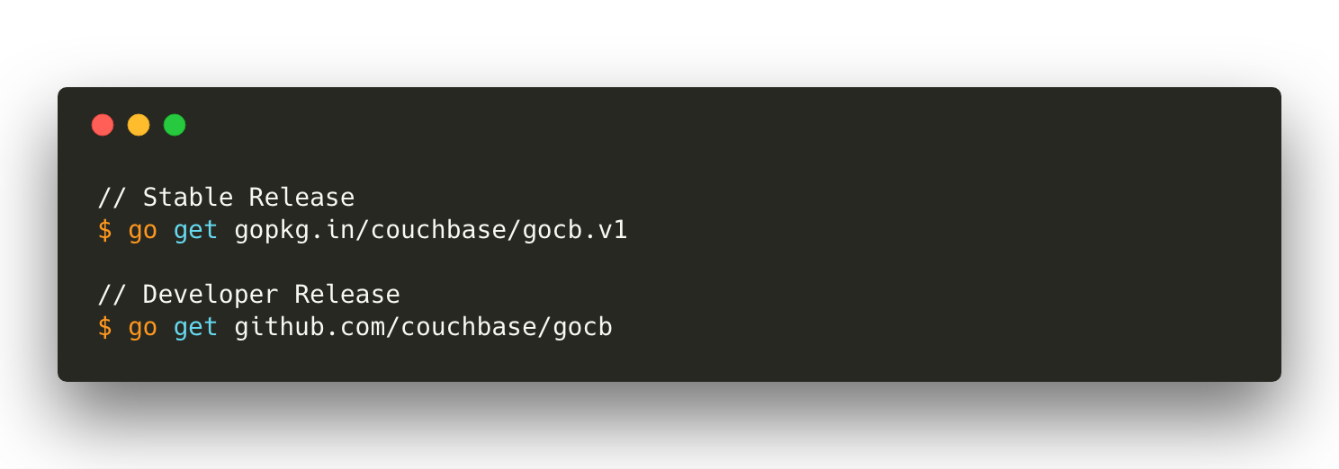

Slide 27
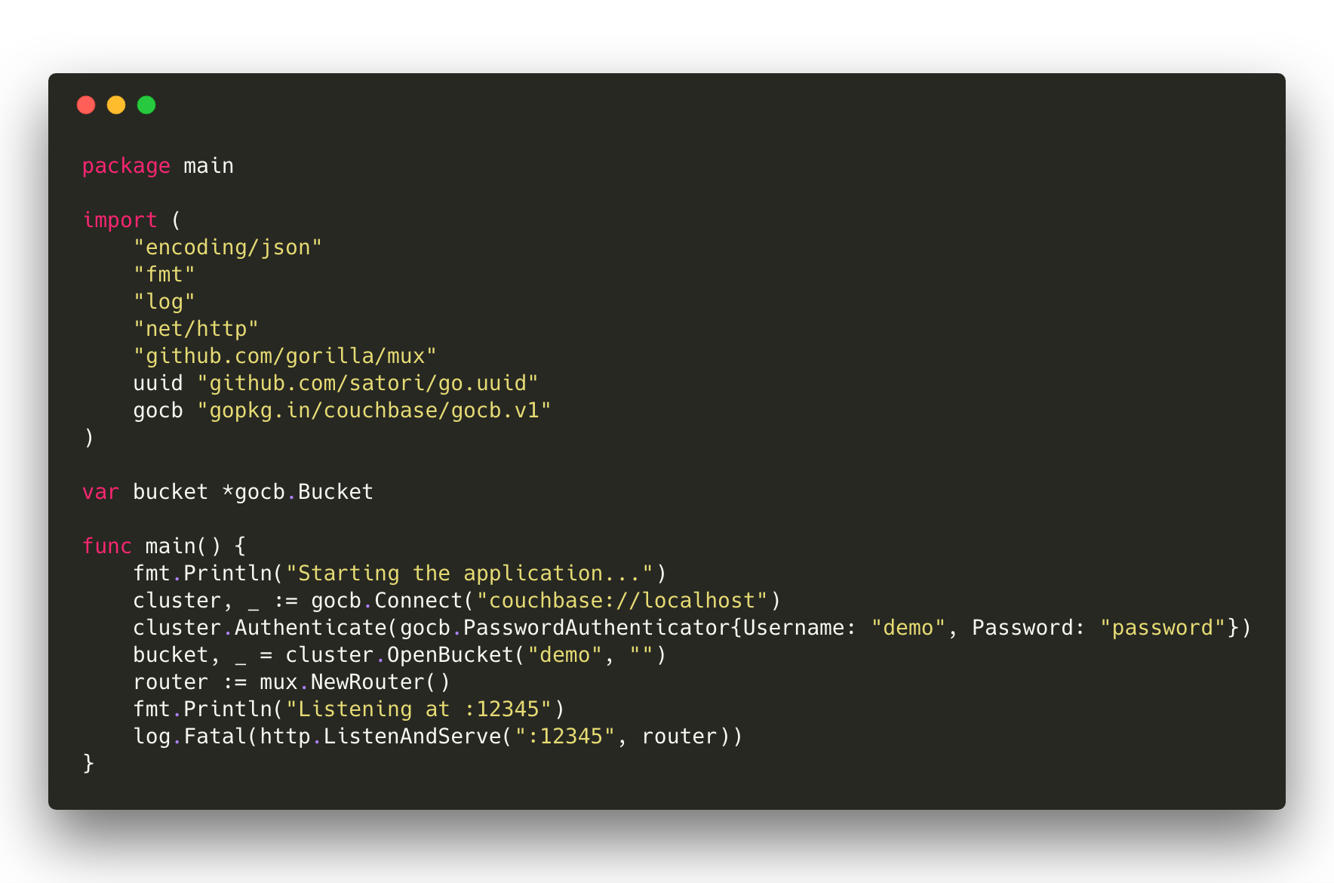

Slide 28
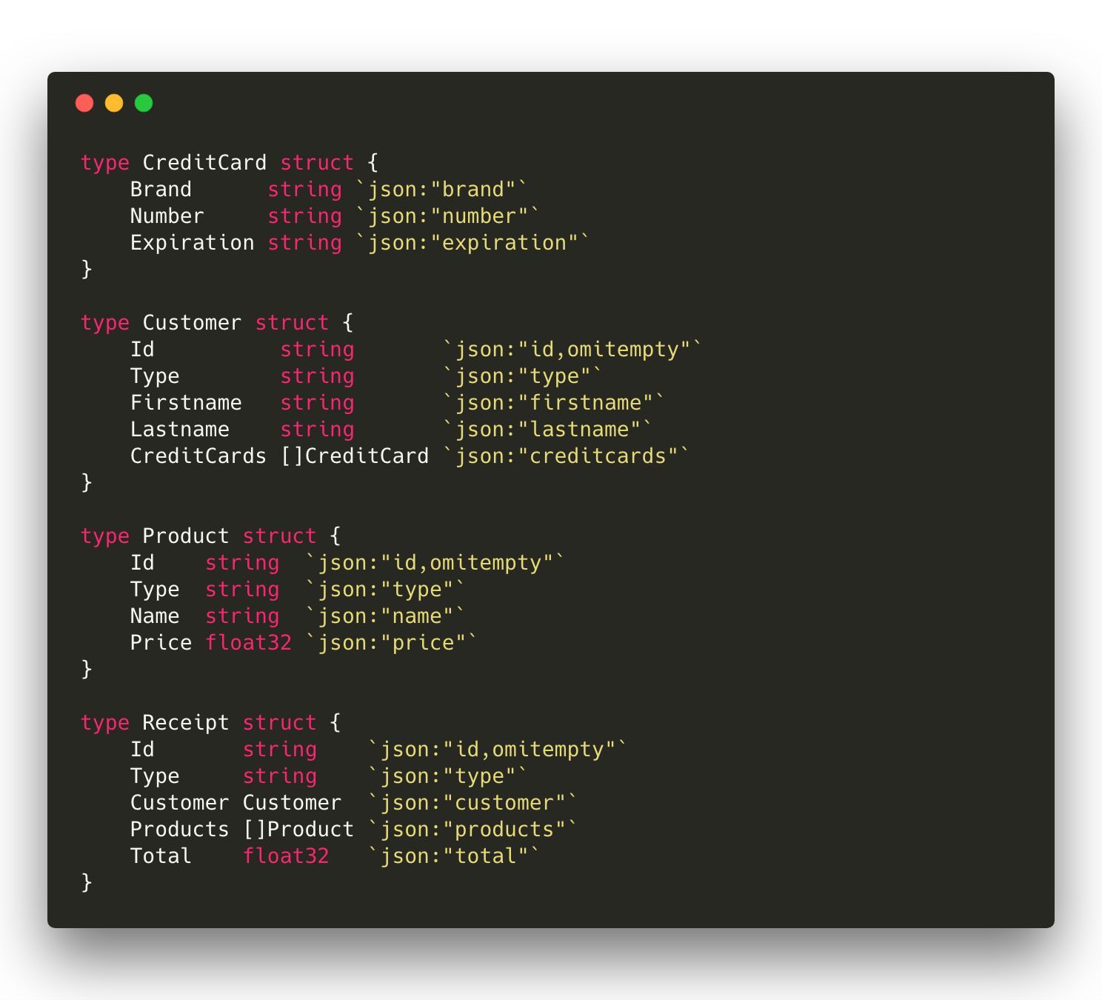

Slide 29
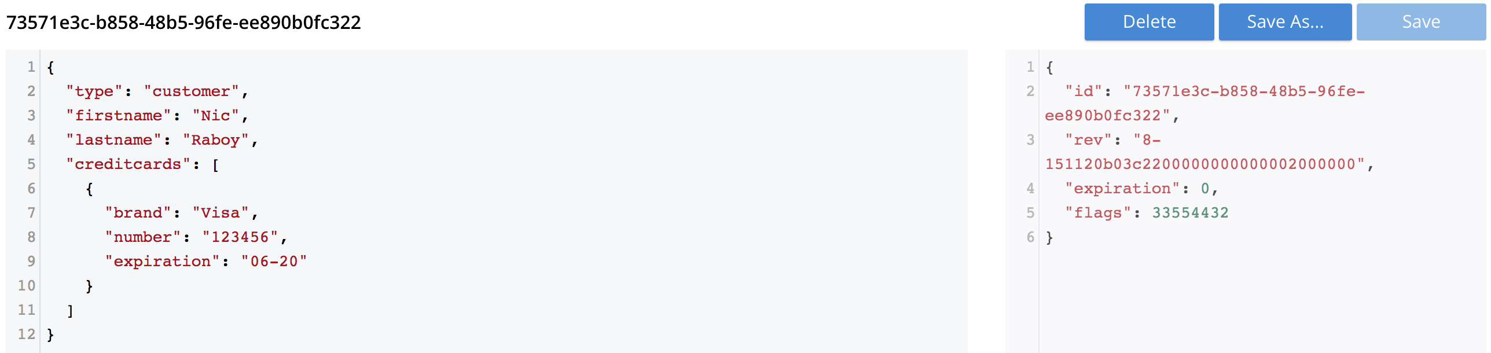
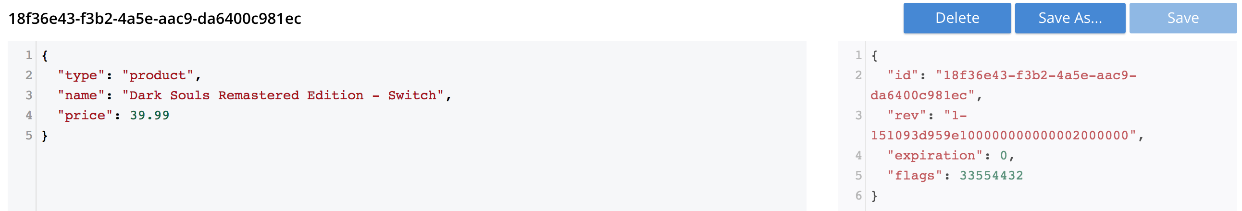
JSON in Couchbase

Slide 30
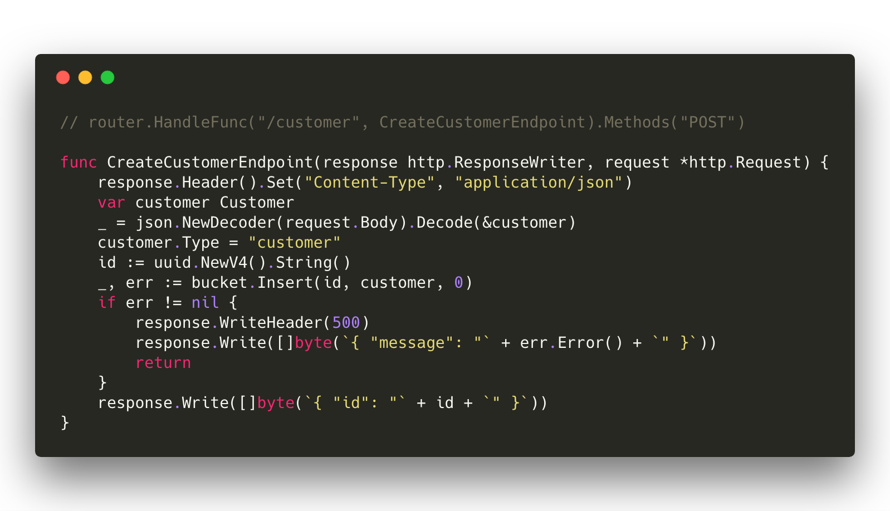
Notes:
Create a new document that represents a customer.

Slide 31
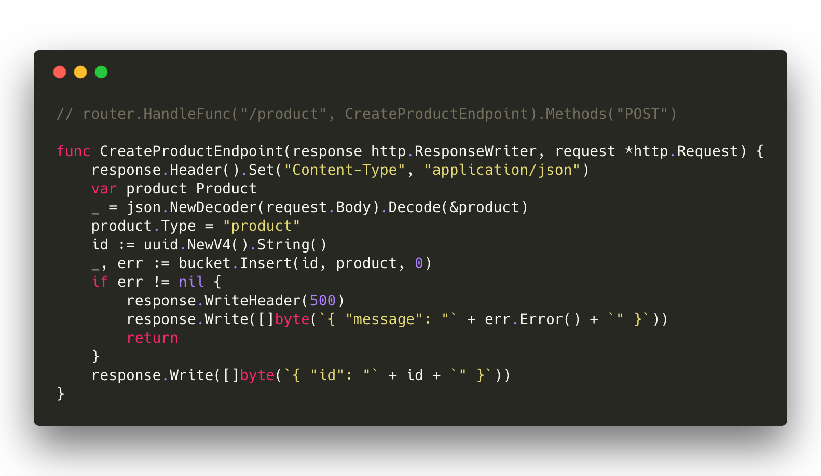
Notes:
Create a new document that represents a product.

Slide 32
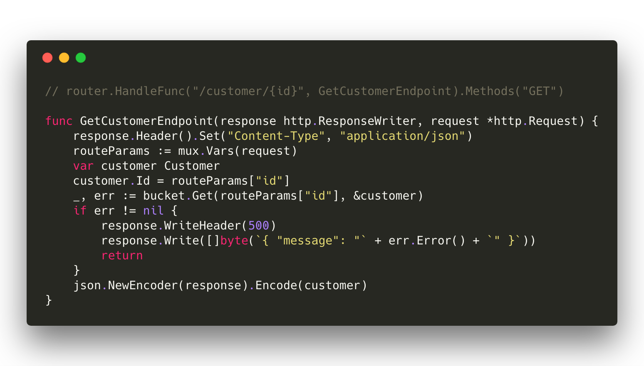

Slide 33
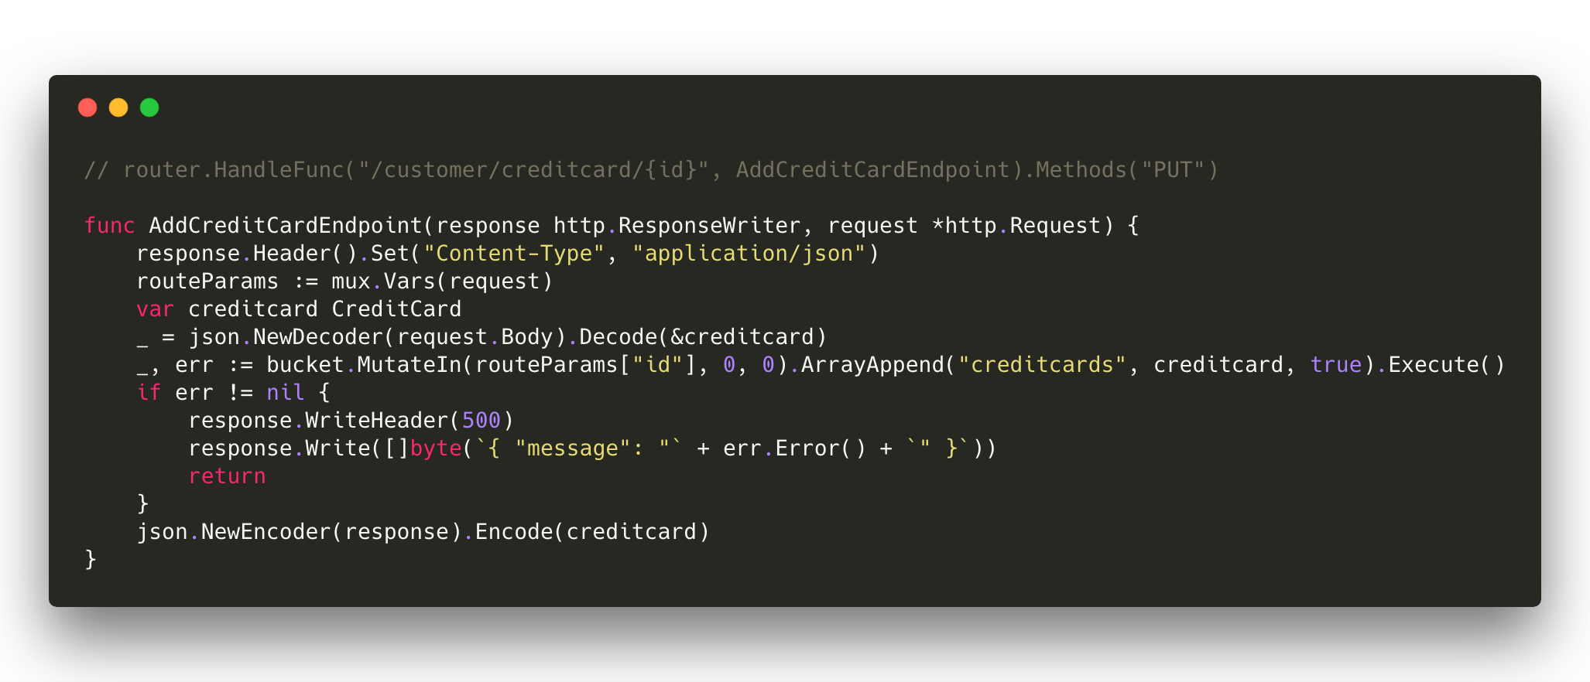
Notes:
Create a new document that represents a customer.

Slide 34
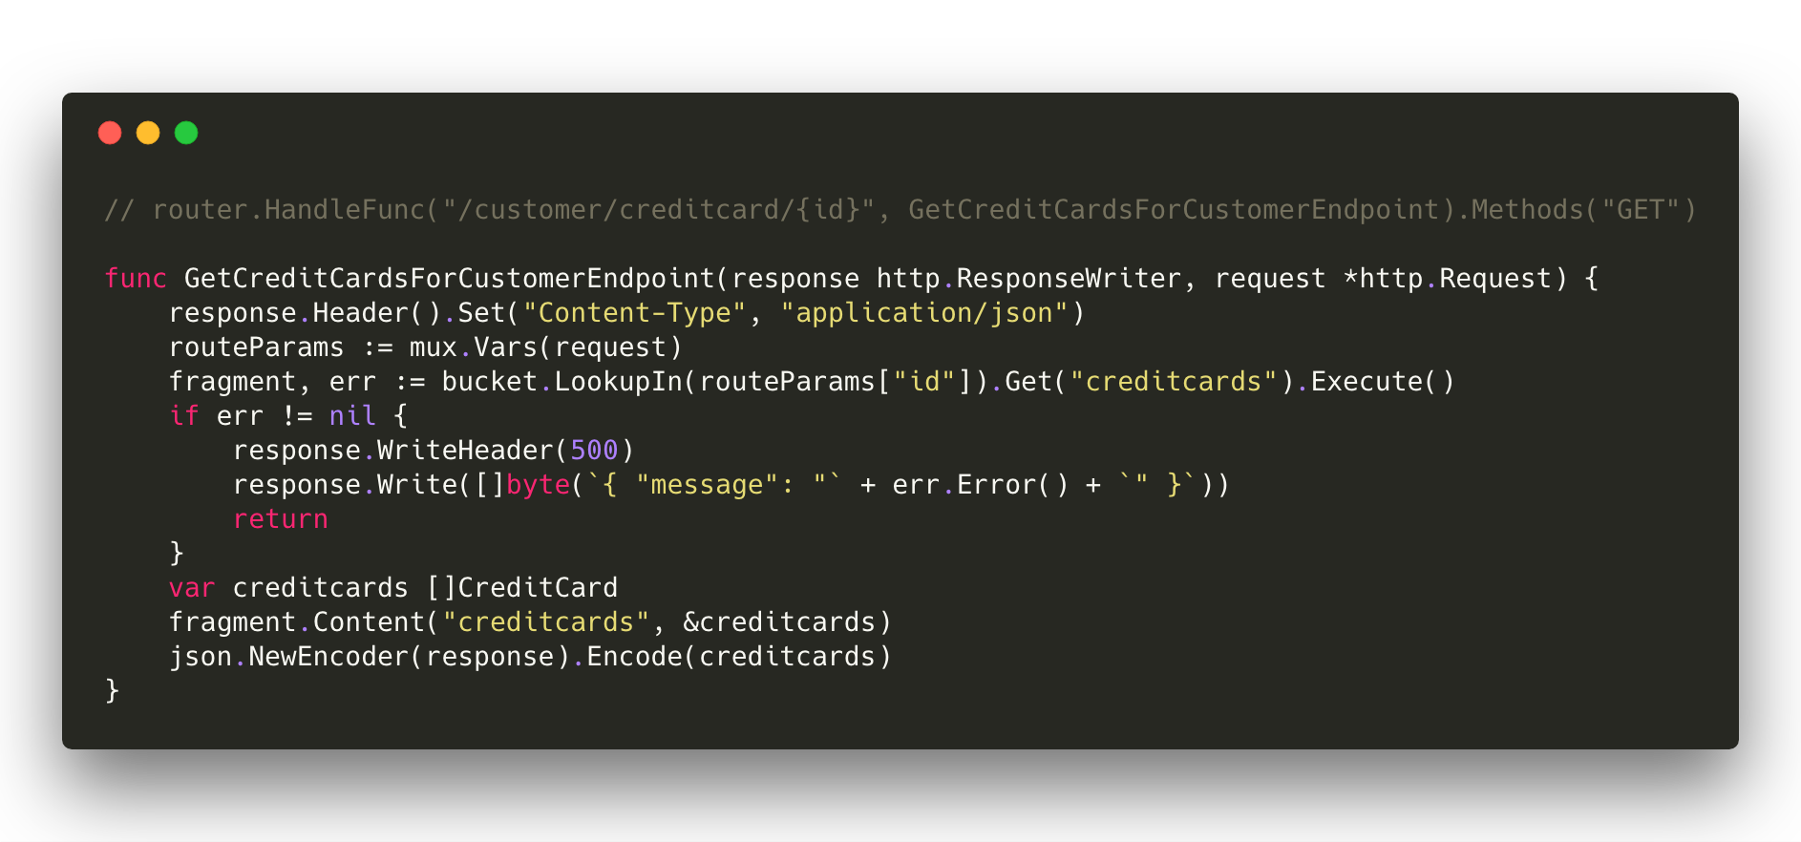
Notes:
Create a new document that represents a customer.

Slide 35
Querying for Documents with N1QL

Slide 36


What is N1QL?
Non-first (N1) Normal Form Query Language (QL)
It is based on ANSI 92 SQL
Its query engine is optimized for modern, highly parallel multi-core execution
SQL-like Query Language
Expressive, familiar, and feature-rich language for querying, transforming, and manipulating JSON data
N1QL extends SQL to handle data that is:
Nested: Contains nested objects, arrays
Heterogeneous: Schema-optional, non-uniform
Distributed: Partitioned across a cluster
Power of SQL
Flexibility of JSON

Slide 37
N1QL (EXPRESSIVE)
Access to every part of JSON document
Scalar & Aggregate functions
Subqueries in the FROM clause
Aggregation on arrays
Expressive, familiar, and feature-rich language for querying, transforming, and manipulating JSON data

Slide 38
N1QL (FAMILIAR)
SELECT * FROM bucket WHERE …
INSERT single & multiple documents
UPDATE any part of JSON document & use complex filter
DELETE
MERGE two sets of documents using traditional MERGE statement
EXPLAIN to understand the query plan
EXPLAIN SELECT * FROM bucket WHERE …
Expressive, familiar, and feature-rich language for querying, transforming, and manipulating JSON data

Slide 39
N1QL (FEATURE-RICH)
Access to every part of JSON document
Functions (Date, Pattern, Array, Conditional, etc)
https://developer.couchbase.com/documentation/server/current/n1ql/n1ql-language-reference/functions.html
JOIN, NEST, UNNEST
Covering Index
Prepared Statements
USE KEYS, LIKE
Expressive, familiar, and feature-rich language for querying, transforming, and manipulating JSON data

Slide 40
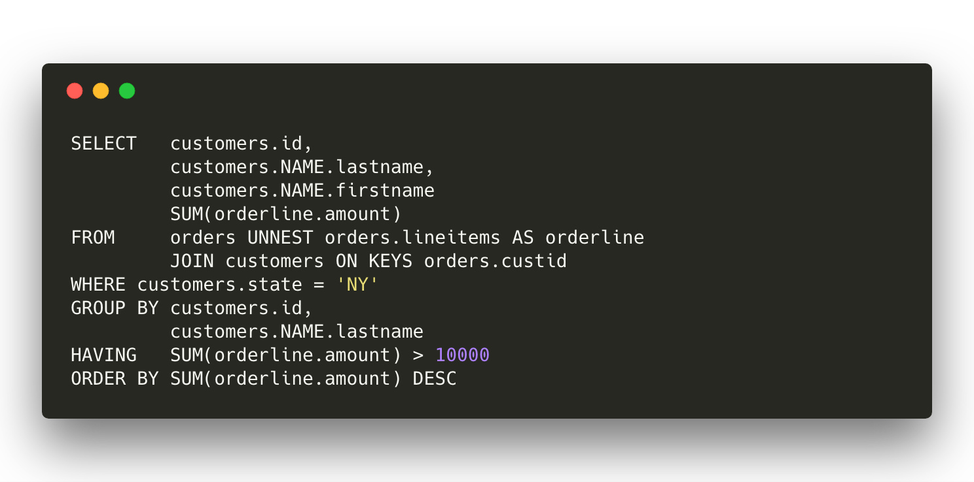
Notes:
Create a new document that represents a customer.

Slide 41
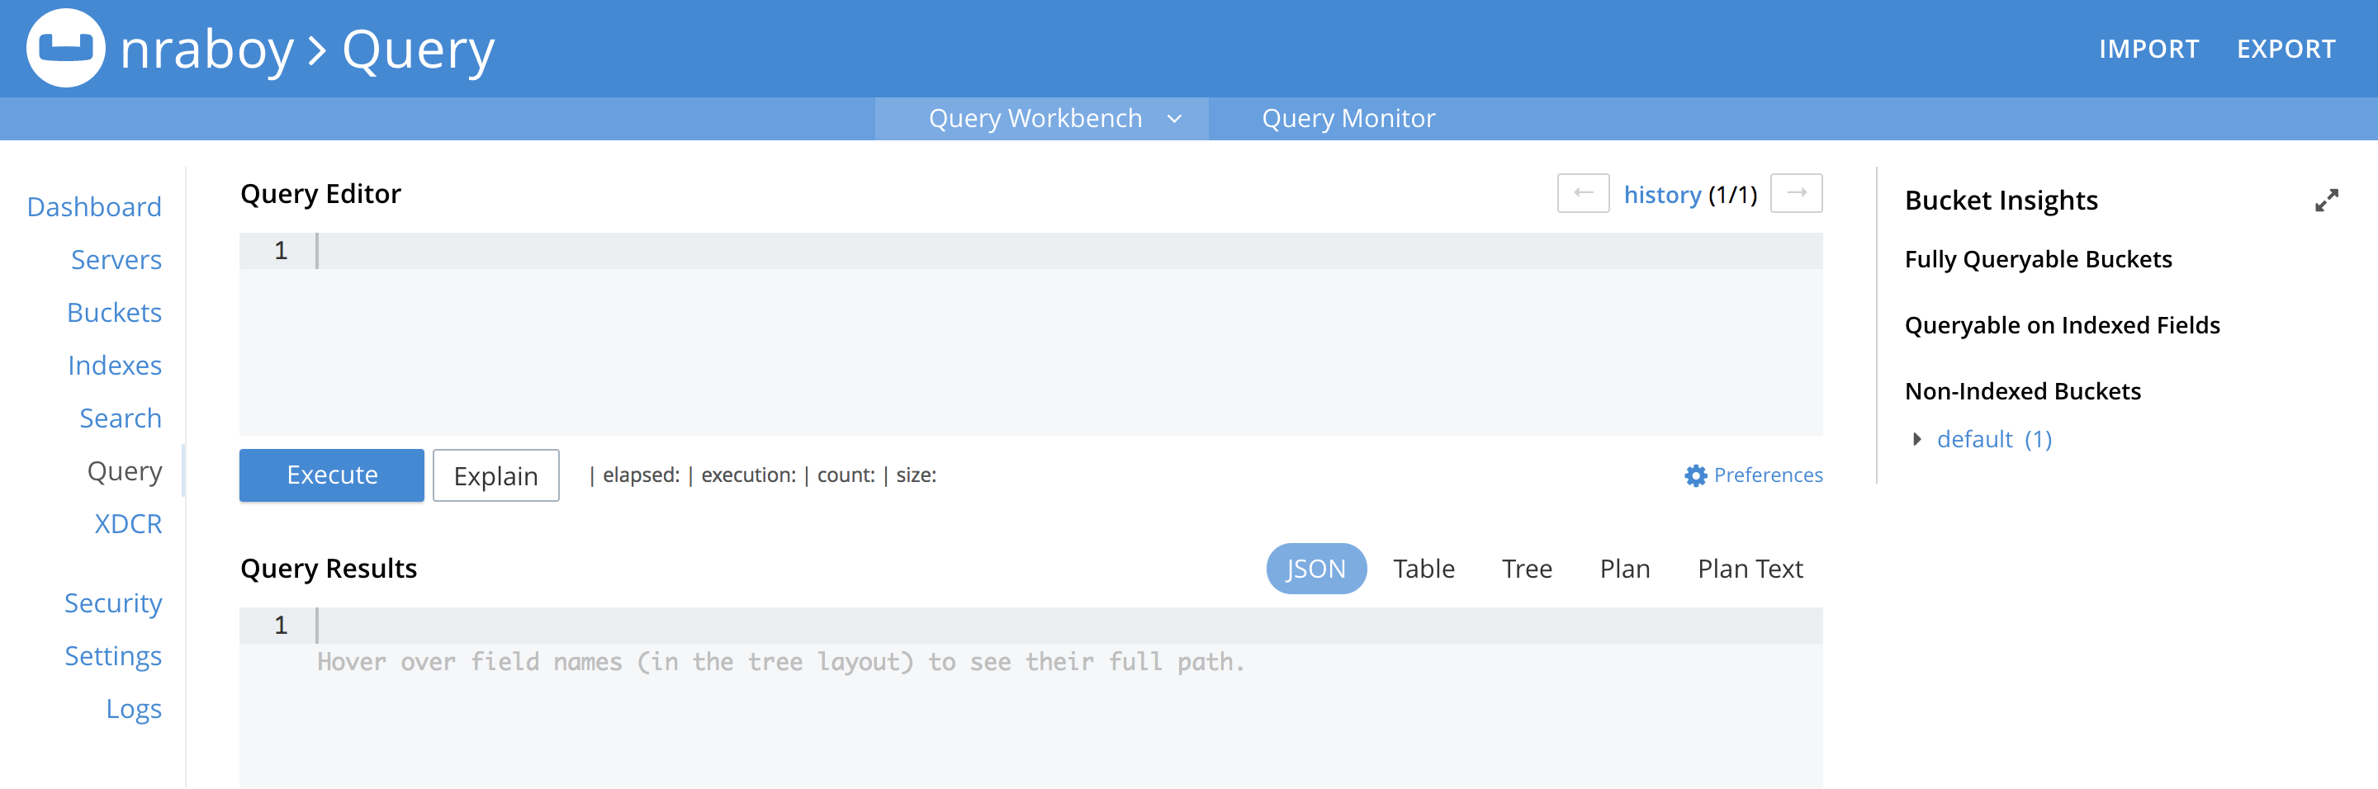
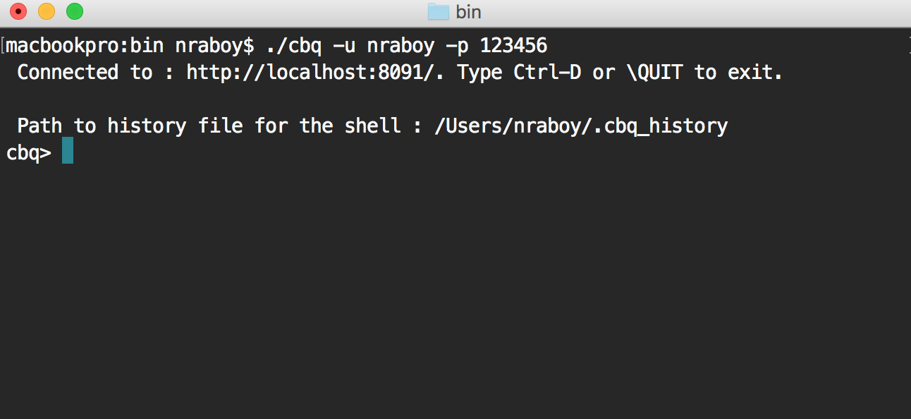
Query Workbench and the Couchbase CLI

Slide 42
Query Workbench and the Couchbase CLI
Query Workbench
http://localhost:8091/ui/index.html#!/query/workbench
Couchbase CLI (Mac)
/Applications/Couchbase Server.app/Contents/Resources/couchbase-core/bin/cbq
Couchbase CLI (Windows)
C:\Program Files\CouchbaseServer\bin\cbq.exe
Couchbase CLI (Linux)
/opt/couchbase/bin/cbq

Slide 43
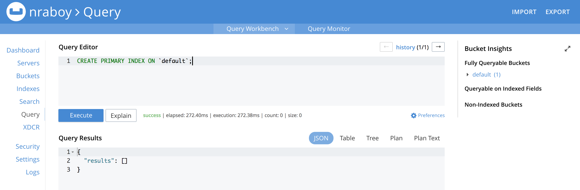
Indexing and Querying in Couchbase Server

Slide 44
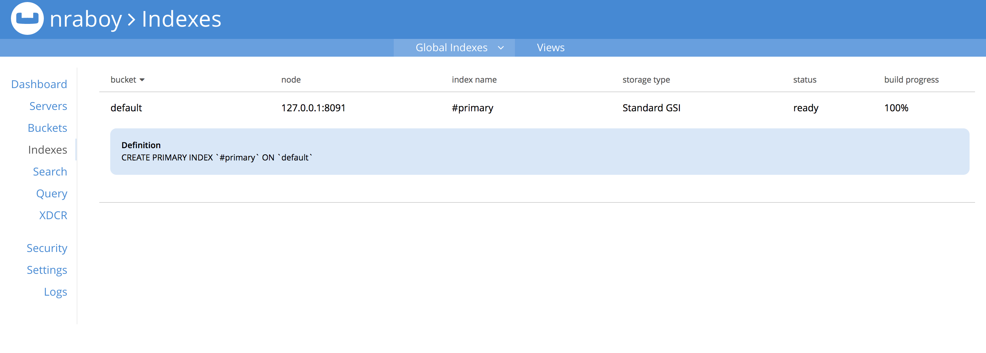
Indexing and Querying in Couchbase Server

Slide 45
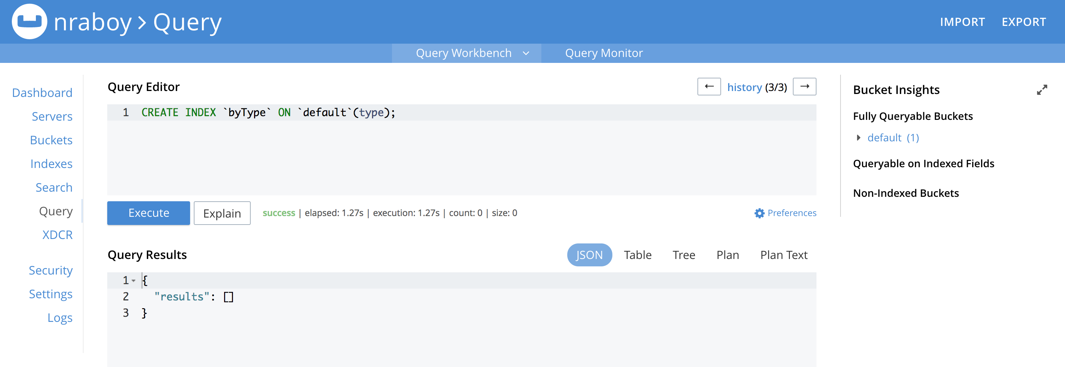
Indexing and Querying in Couchbase Server

Slide 46
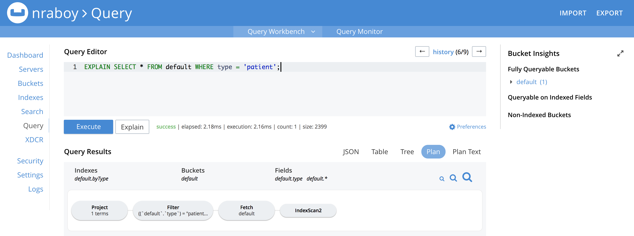
Indexing and Querying in Couchbase Server

Slide 47
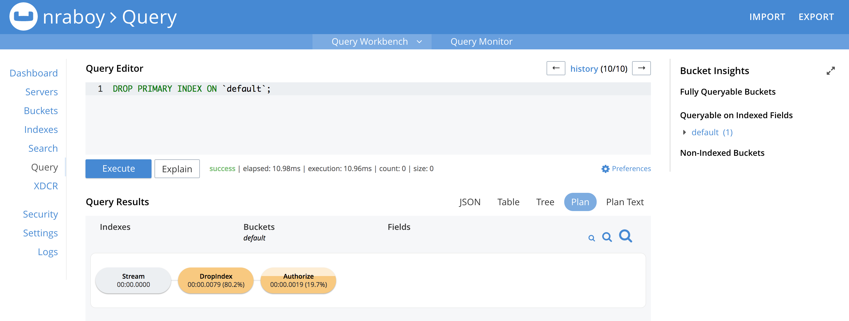
Indexing and Querying in Couchbase Server

Slide 48
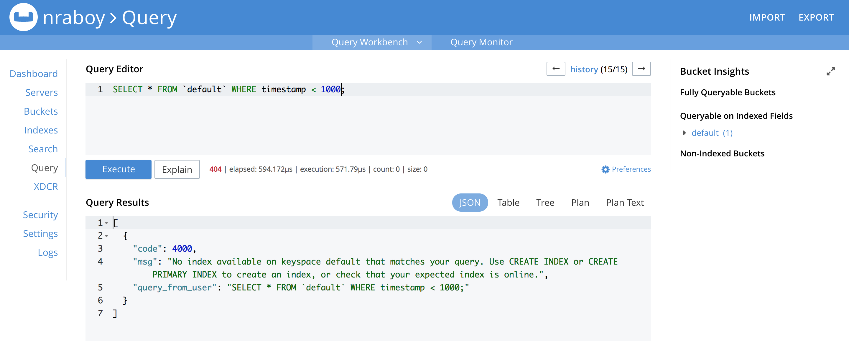
Indexing and Querying in Couchbase Server

Slide 49
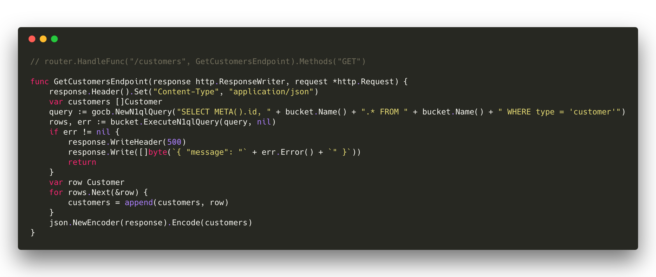
Notes:
Create a new document that represents a customer.

Slide 50

Notes:
Create a new document that represents a customer.

Slide 51
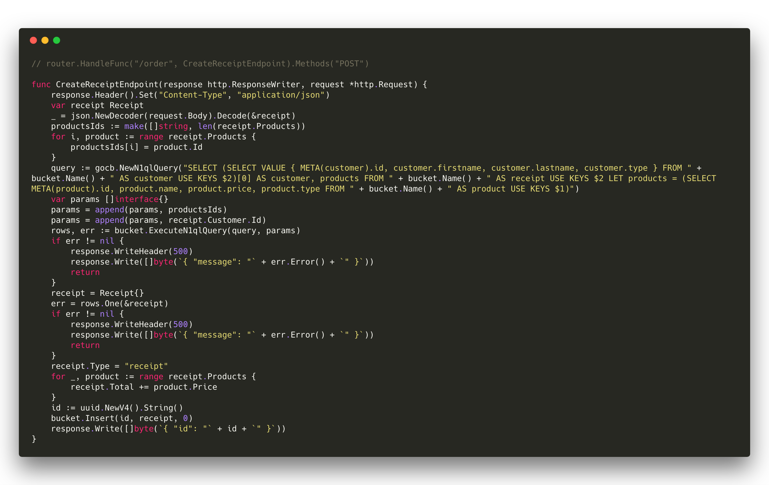
Notes:
Create a new document that represents a customer.

Slide 52
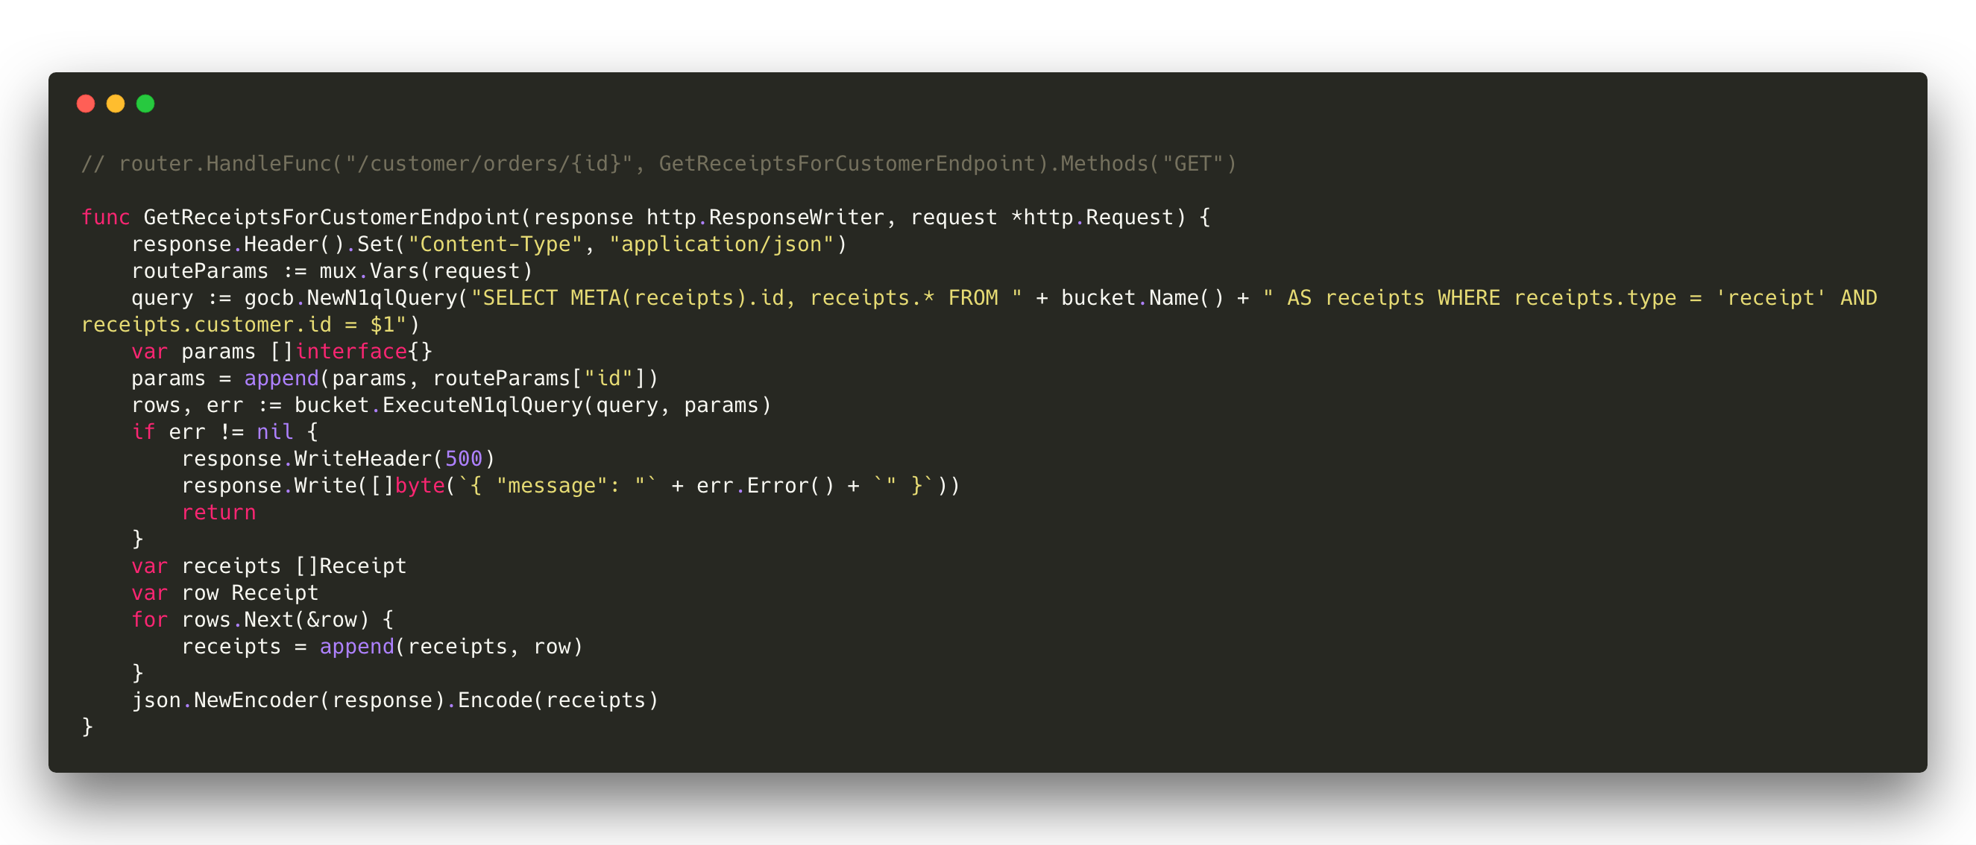
Notes:
Create a new document that represents a customer.

Slide 53
Project Code
https://github.com/couchbaselabs/golang-api-example

Slide 54
Go SDK Documentation
https://godoc.org/github.com/couchbase/gocb

Slide 55
More Go Ideas

Slide 56
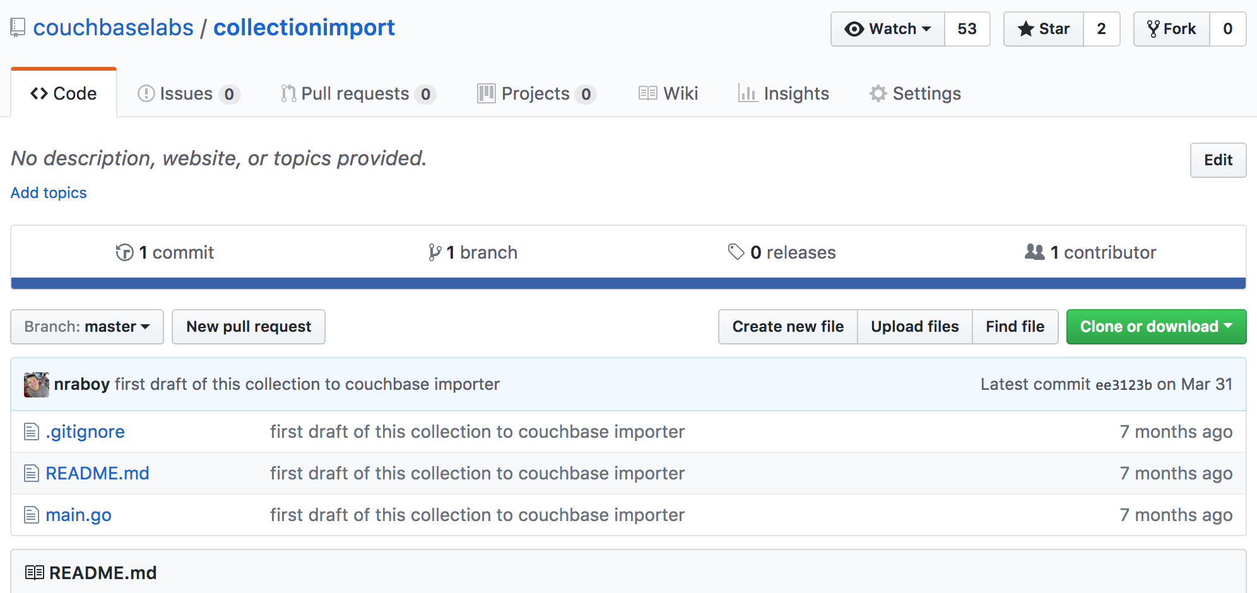
Data Importing with Go
https://github.com/couchbaselabs/collectionimport

Slide 57
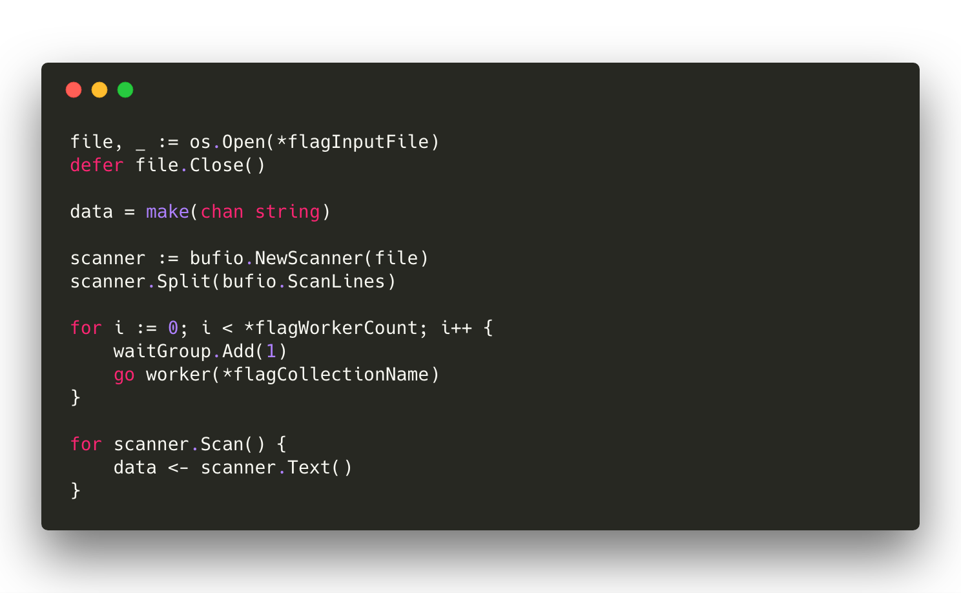
Notes:
Create a new document that represents a customer.

Slide 58
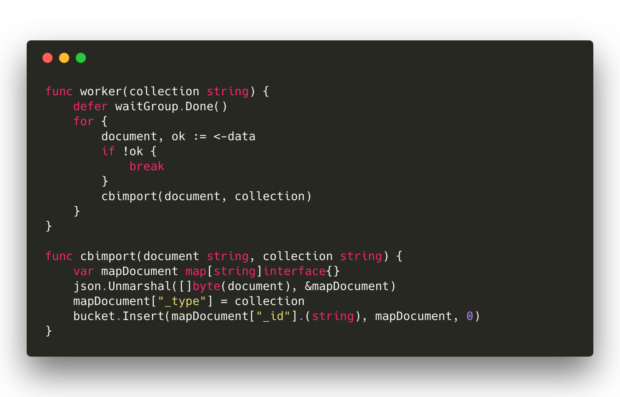
Notes:
Create a new document that represents a customer.

Slide 59
What’s Next – More Help
Couchbase Developer Portal – https://developer.couchbase.com
Couchbase Tutorials – https://blog.couchbase.com
Forums – https://forums.couchbase.com
Twitter - @couchbase, @couchbasedev, @nraboy

